Slide 1
Team formation tool team : code crafters

Slide 2
TEAM MEMBERS:
APPU - 3BR22CS014
PRAVEEN KUMAR NAIK – 3BR22CS124
SNEHA BAI.RC - 3BR22CS163
SINDHU – 3BR22CS160

Slide 3
INTRODUCTION:
Entity Modeling:
The project utilizes object-oriented programming principles to define two main entities: Player and Team. These classes encapsulate relevant attributes and behaviors for managing player profiles and team
CRUD Operations:
The application supports Create, Read, Update, and Delete operations for player profiles, allowing users to efficiently manage player information.
Team Formation Algorithm:
A specialized algorithm is implemented to assist in creating balanced team rosters. This algorithm takes into account various factors such as player skills, statistics, and possibly other parameters depending on the specific requirements of the sport or activity.

Slide 4
Change Tracking:
The application includes functionality to track changes and updates to team formations. This allows for the monitoring of roster adjustments over time, aiding in the evaluation of team performance and strategy refinement
Unit Testing:
To ensure the reliability and robustness of the application, unit tests are implemented using Python’s unittest framework. These tests validate the correctness of individual components and help maintain code quality throughout the development process.

Slide 5
MODULE DESCRIPTION:
Classes:
Player: Represents a player with attributes such as player ID, name, and skills.
Team: Represents a team with attributes such as team ID and name.
Player Database: Manages a collection of players. It has methods to create, read, update, delete, and display players.
Team Database: Manages a collection of teams. It has methods to create, read, update, delete, and display teams.
Unit Tests:
Test Player Database: Contains test cases for the Player Database class.
test create player: Tests the creation of a player.
Test read player: Tests reading a player's information.
Test update player: Tests updating a player's information.
Test delete player: Tests deleting a player.
Test display players: Tests displaying the list of players.
Test Team Database: Contains test cases for the Team Database class.
Test create team: Tests the creation of a team.
Test read team: Tests reading a team's information.
Test update team: Tests updating a team's information.
Test delete team: Tests deleting a team.
Test display teams: Tests displaying the list of teams.

Slide 6
start
start
self.db = PlayerDatabase() self.db.create_player(1, "John Doe", ["football"]) self.db.create_player(2, "Jane Smith", ["cricket"])
self.db = TeamDatabase()
self.db.create_team(1, "A")
self.db.create_team(2, "B")
test_create_team
test_create_player
test_read_player
test_update_player
test_read_team
test_update_team
test_delete_player
test_display_players
test_delete_team
test_display_teams
ok...
stop
ok...
stop

Slide 7
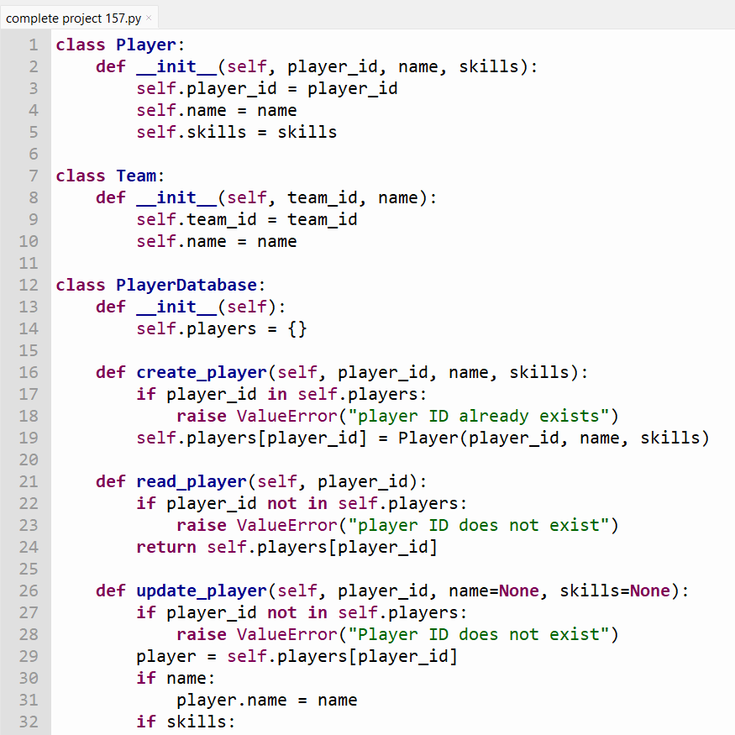

Slide 8
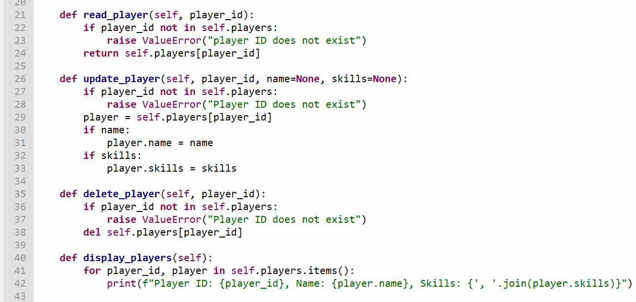

Slide 9
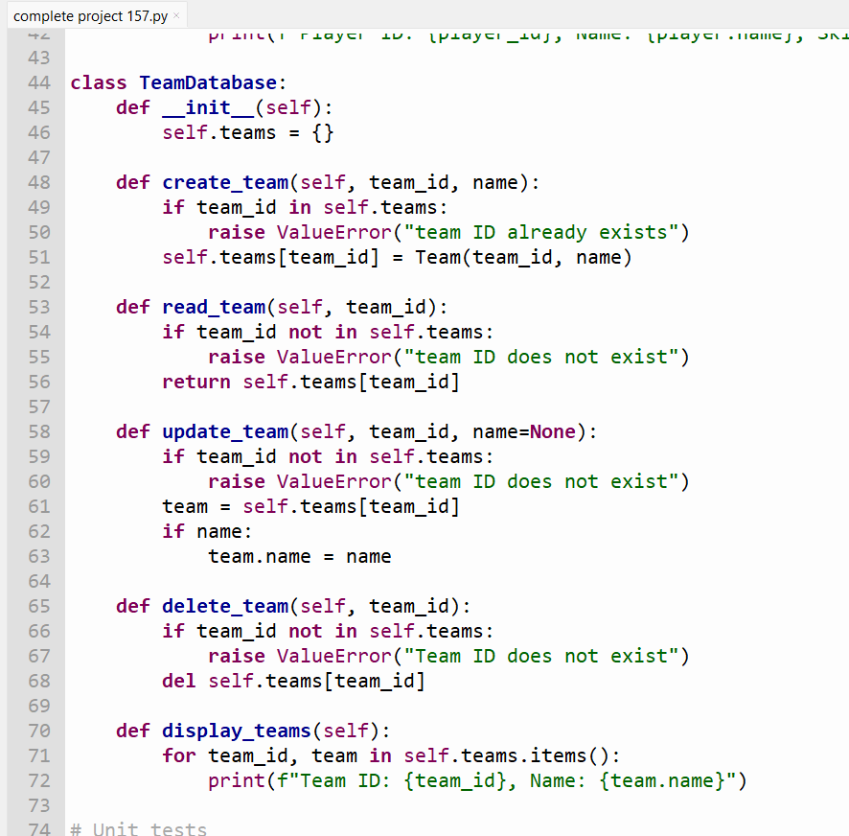

Slide 10
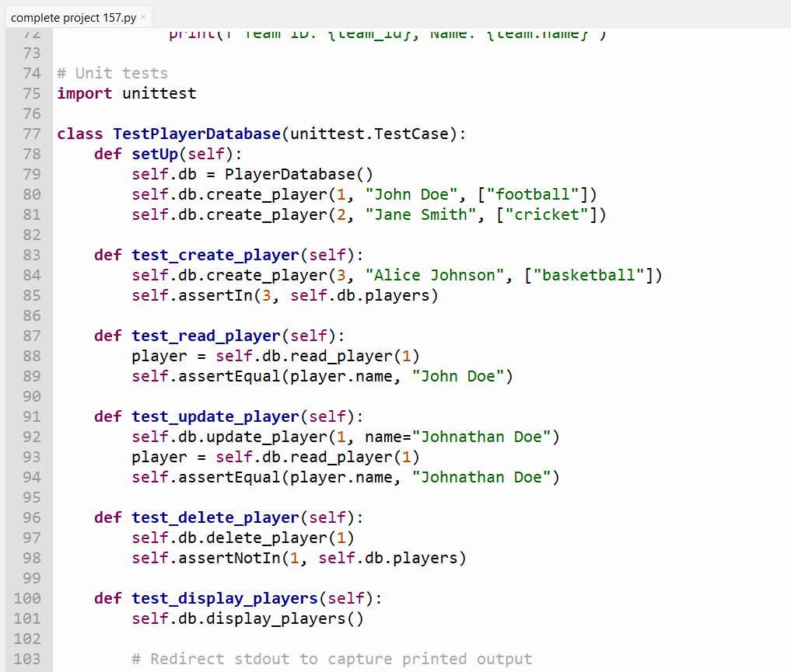

Slide 11
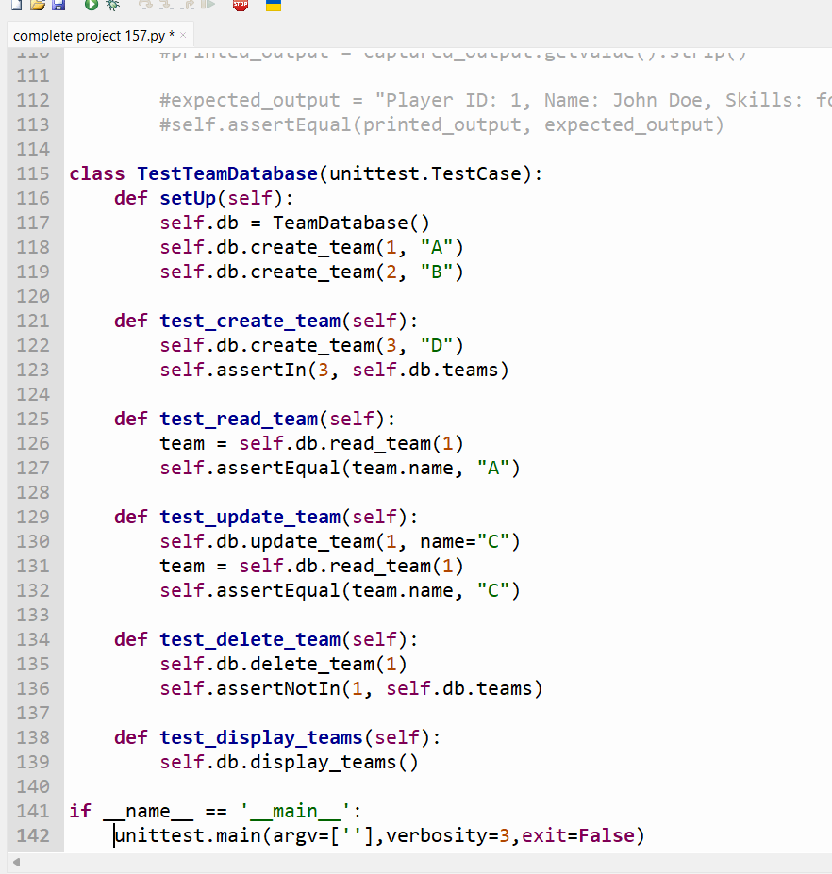

Slide 12
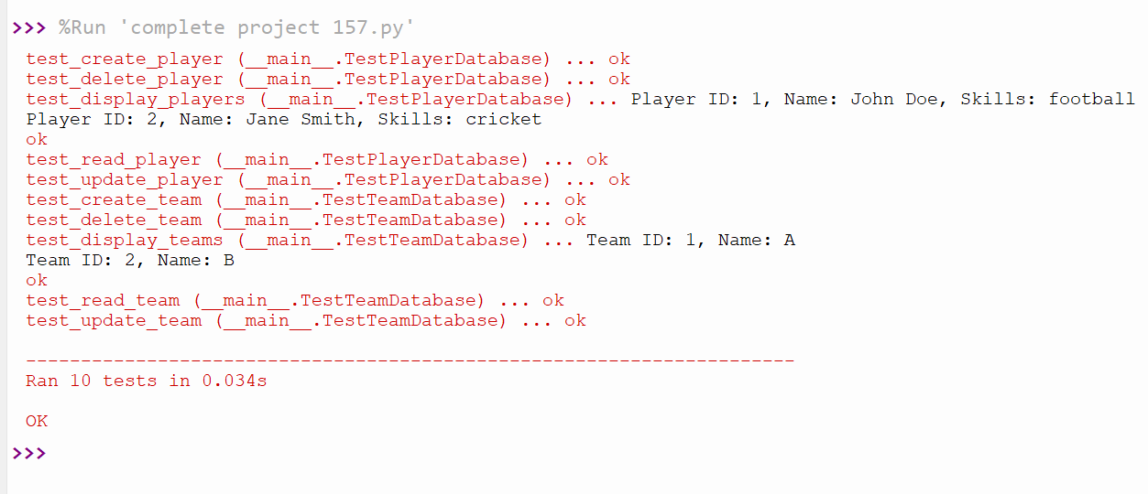
OUTPUT:

Slide 13
Conclusion:
In conclusion, the provided code serves as a foundation for managing player and team data and testing the associated functionality. With some corrections and enhancements, it can be a robust solution for handling player and team management in a sports-related application.

Slide 14
Bibliography:
1.GOOGLE
2.CHAT GPT
3.https://www.w3schools.com/c/index.php
4. Https://www.programiz.com/python-programming
GITHUB ACCOUNTS:
1.https://github.com/snehabai/SNEHA
2. https://github.com/Praveen9964935712/BITM
3.https://github.com/Appu-nayak
4.https://github.com/account_verifications

Slide 15
Thank you
🙏
நன்றி

